Slide 1

Anime_World
Presented by :
Gopi V 512223104030
Jaya Chandru B 512223104301
Meganathan K 512223104058
Santhosh Kumar U 512223104303

Slide 2

Content
Concept
Objectives
Problem Statement
Problem Solution
Target Audience
Design Process Overview: UX Stages
Understanding Our Users: Persona Overview
Qualitative Research
SWOT
Empathy Analysis
Competitor Analysis
User Flow
Information Architecture
UI Design Kit

Slide 3
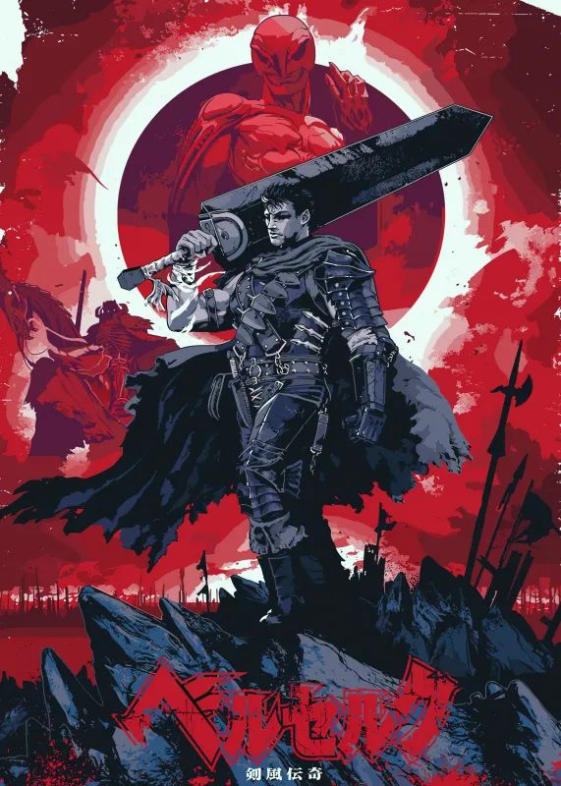
Concept
Anime_World is a web-based platform that reimagines the way anime fans explore and engage with seasonal anime.
Inspired by AniChart, it not only provides schedules and details for ongoing and upcoming anime but also introduces a community-driven experience where users can interact, comment, and discuss their favorite series directly on the platform.
The platform blends information and interaction, turning anime discovery into a social experience.

Slide 4

Objective
• Enhance User Engagement – Allow anime fans to communicate, share thoughts, and react to new shows directly within the platform.
• Simplify Anime Discovery – Provide easy access to seasonal anime information, airing dates, genres, and studios.
• Improve User Retention – Encourage users to return frequently by offering discussions, notifications, and trending community sections.
• Build a Connected Anime Community – Create a social ecosystem where users feel part of a fandom without leaving the site.

Slide 5

Problem Statement
Current anime listing websites (like AniChart) primarily focus on schedules and basic information but lack user interaction.
Fans often have to switch between multiple platforms one to track anime, another to read reviews, and another (like Reddit or Discord) to discuss them.
This creates a fragmented experience and reduces engagement. There is a clear need for an integrated platform where anime discovery and community discussion coexist seamlessly.

Slide 6
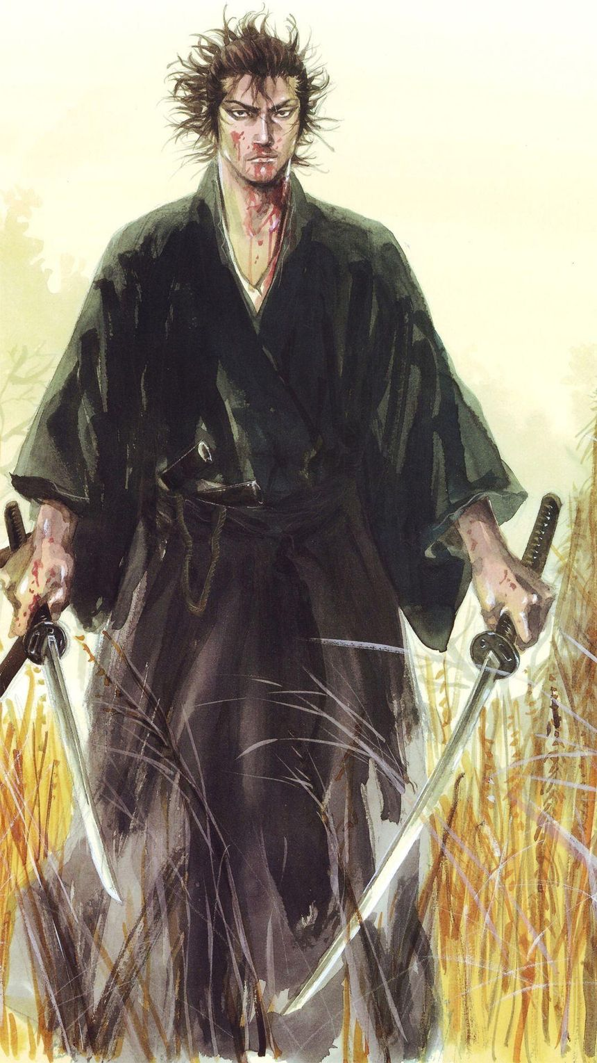
Problem Solution
Anime_World solves this gap by combining the core features of AniChart (seasonal listings, schedules, and tracking) with a community comment system on each anime’s page.
Key aspects of the solution:
• Users can explore anime by season and click on any anime to view its details.
• Each anime has its own comment section for discussions, reviews, and reactions.
• Community-driven features like likes, replies, spoiler tags, and trending discussions enhance engagement.

Slide 7



Audience Type | Description
Anime Enthusiasts (Age 15–30) | Fans who actively watch new and upcoming anime each season.
Casual Viewers | Users who only follow popular shows and want updates or recommendations.
Community Members | People who enjoy interacting with others and sharing opinions.
Reviewers / Critics | Users who write or share anime impressions.
Target
Audience

Slide 8
Design Process Overview: UX Stages
Research & Analysis
Wireframing & Layout
Testing & finalizing
Study AniChart
Identify gaps
Understand users
Collect feedback
Improve design
Final review
Build structure
Arrange elements
Design layout
Define concept
Plan features
Create flow
Apply theme
Create UI
Link pages
Ideation & Planning
Visual Design & Prototype

Slide 9
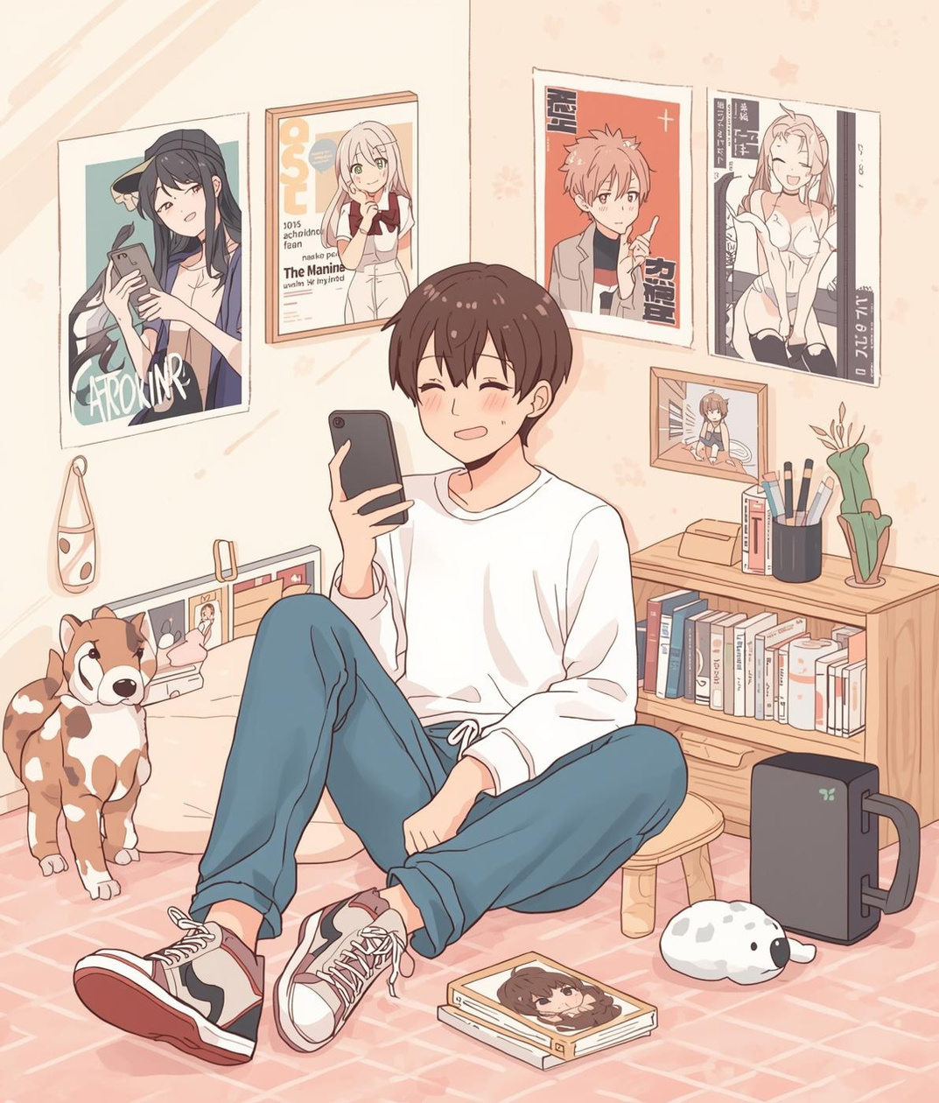
Understanding Our Users: Persona Overview
Meet Alex, a dedicated anime enthusiast navigating scheduling challenges.
Alex, a 24-year-old anime fan, struggles to keep track of new releases and manage watchlists effectively. His primary goal is to simplify the anime scheduling process, ensuring he never misses an episode. Frustrated by complex apps, he seeks a user-friendly solution that enhances his viewing experience, helping him fully enjoy his passion for anime.

Slide 10

Qualitative Research
What features or aspects do you find most useful or enjoyable?
Have you faced any difficulties or frustrations while using similar apps?
How satisfied are you with the user experience of your current preferred app?
What do you like or dislike about the interface or navigation in those apps?
Are there any features you wish existed that would make the experience better?
Would you recommend your preferred app to others? Why or why not?

Slide 11
SWOT
S W O T
Strength
Modern, anime-inspired UI design
Combines schedule + community in one site
User-friendly layout and navigation
Weakness
New platform, lacks existing user base
Requires continuous data updates for anime seasons
Comment moderation needed to prevent spam
Opportunities
Growing global anime audience
Potential for social community growth
Monetization via ads or premium features
Threats
Established competitors (AniChart, MyAnimeList)
Frequent changes in anime release data
User engagement may drop without active updates

Slide 12
Empathy Analysis
Says
Users often express appreciation for the platform’s clean, visually appealing interface and how it streamlines the process of tracking seasonal anime.
Comments include requests for features like easier rating systems, customizable status dropdowns, and favorites showing up on their profile.
Does
Users actively track airing anime seasons, update their watching lists, and share top-rated shows on social media.
Many engage in forum discussions, provide feedback about missing features or desired improvements, and import/export anime lists from other platforms.
Feels
Users report feeling excitement and anticipation due to countdowns and seasonal previews.
There is a general sense of satisfaction from the ease of use, but also some frustration when feature requests are unmet or when compared to other platforms.
Thinks
Users value reliability, intuitive design, and aesthetic qualities; they compare AniChart favorably to alternatives, thinking the experience is smooth and rewarding.
They contemplate the utility of multiple rating systems and ponder the future and improvements for AniChart.

Slide 13
Competitor Analysis
Criteria | Ani Chart | MyAnimeList | Anime Planet | Anime_World (Proposed)
Purpose | Shows seasonal anime schedules | Database of anime/manga with reviews | Streaming info + community site | Combines anime schedules with social interaction
Target Audience | Seasonal anime watchers | Anime enthusiasts and reviewers | Casual anime viewers | Anime lovers who want both info + discussion
UI / Design | Clean, minimal, grid-based | Dense, text-heavy layout | Balanced but cluttered | Modern, minimal, anime-inspired dark theme
Ease of Use | Easy navigation | Slightly complex | Moderate | Simple navigation, user-friendly
Community Features | ❌ None | ✅ Reviews & forums | ✅ User lists & discussions | ✅ Integrated comment section on each anime

Slide 14
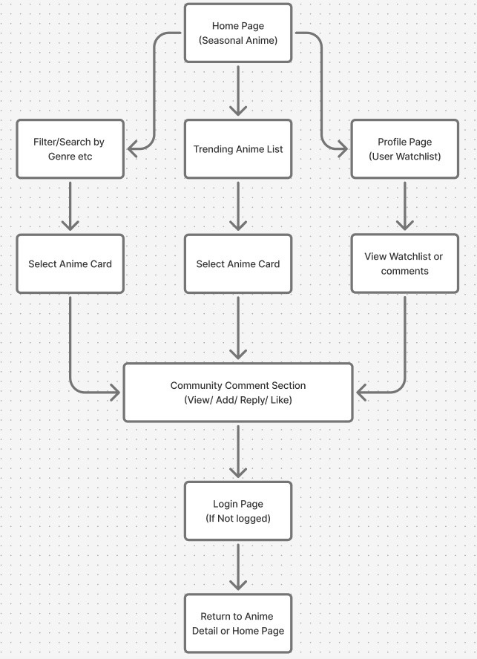
User Flow

Slide 15
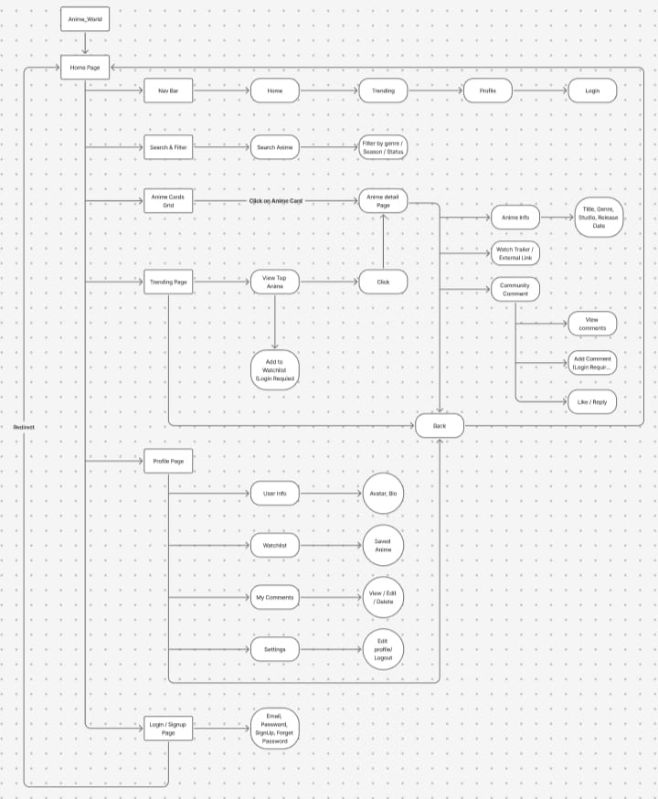
Information Architecture

Slide 16
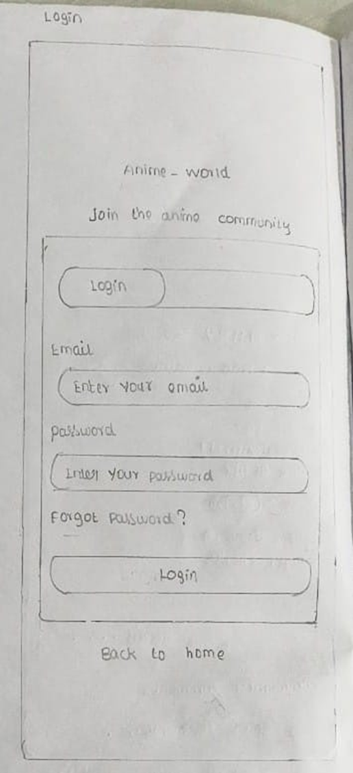
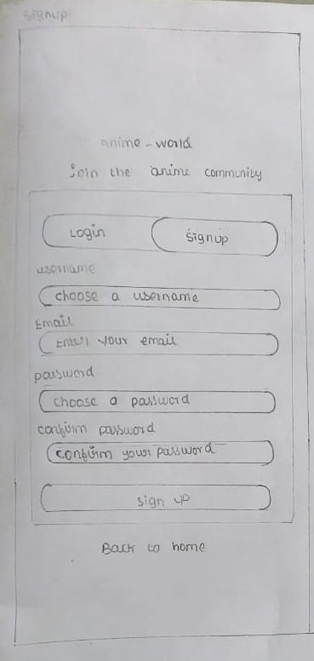
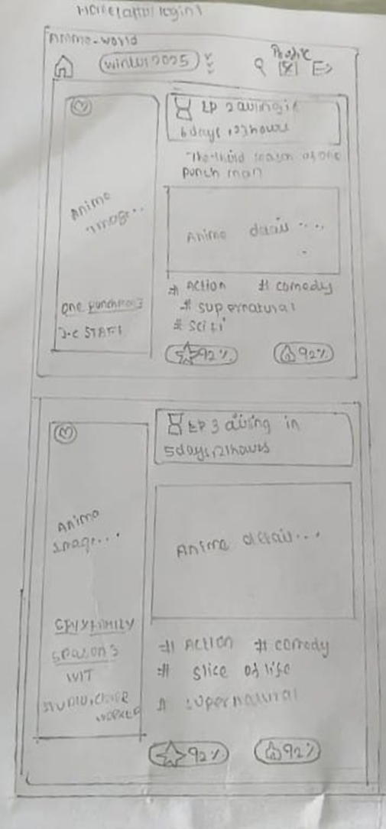
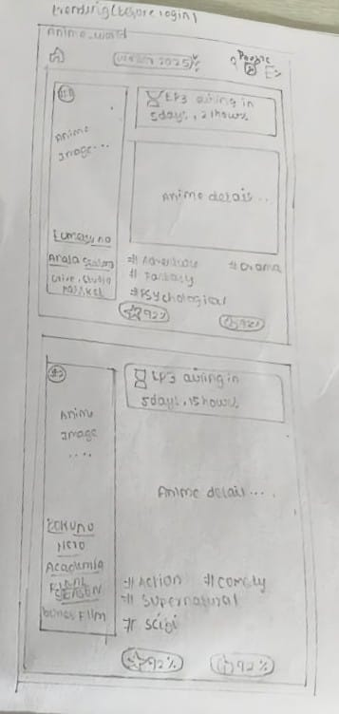
UI Design Kit : Low Fidelity
Login
Sign Up
Home
Trending

Slide 17
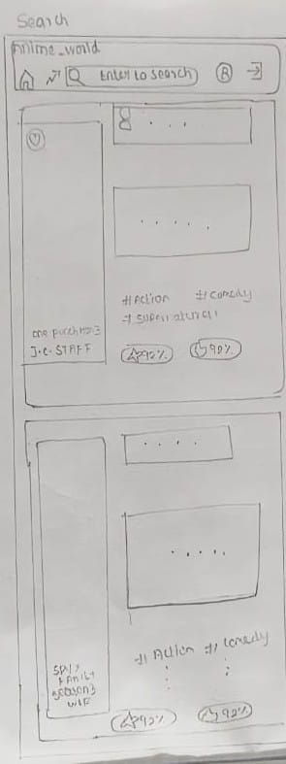
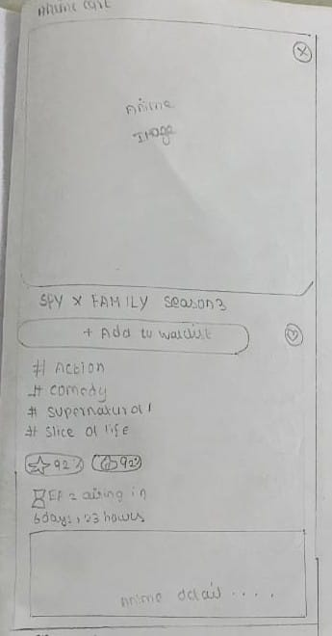
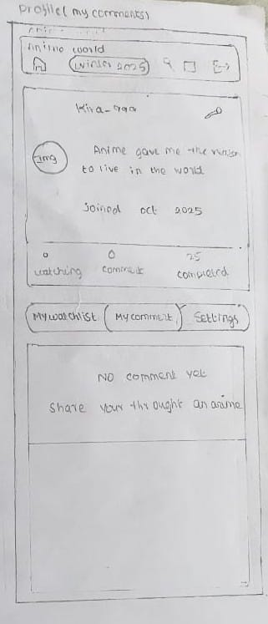
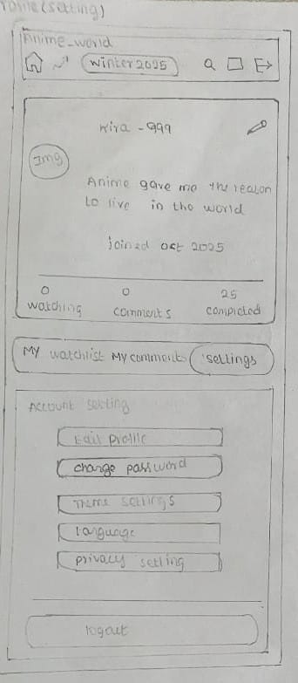
UI Design Kit : Low Fidelity
Search
Anime Card
Profile (My Comments)
Profile (My Settings)

Slide 18
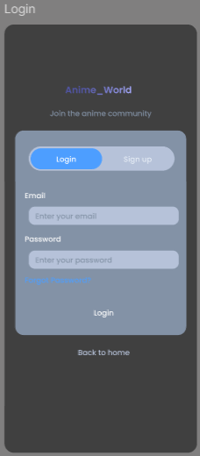
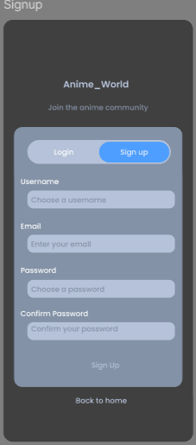
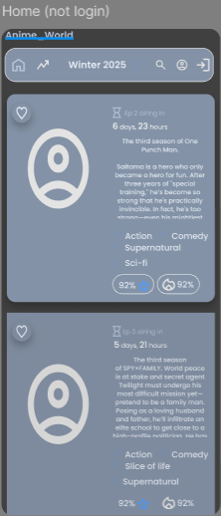
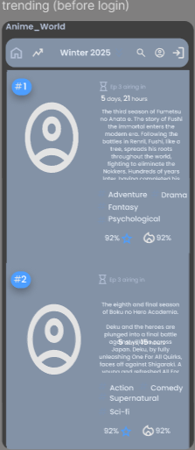
UI Design Kit : Mid Fidelity
Login
Sign Up
Home
Trending

Slide 19
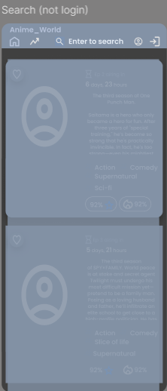
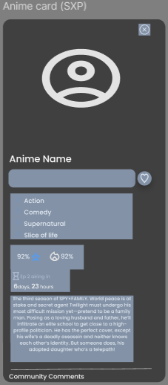
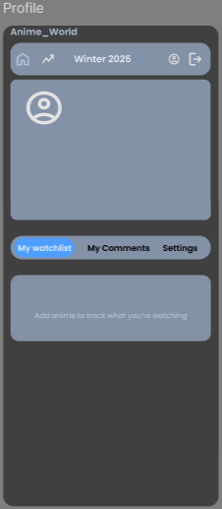
UI Design Kit : Mid Fidelity
Search
Anime Card
Profile

Slide 20
UI Design Kit : Color
Dark / Background
Dark / Surface
Dark / Elevated
#0F1B2C
#14213D
#0E1621

Slide 21
UI Design Kit : Color
Accent / Blue
Accent / Purple
Accent / Cyan
#B38BFA
#53E0E8
#4D9EFF

Slide 22
UI Design Kit : Color
Text / Primary
Text / Secondary
Text / Muted
#B6C2D9
#8392A6
#E5ECF5

Slide 23
UI Design Kit : Color
Status / Success
Status / Warning
Status / Danger
#FFC857
#FF6B6B
#5FD788

Slide 24
UI Design Kit : Typography
 | Font Size | Font Weight | Font Family | Colour Scheme
Heading 1 | 22 | Semi Bold | Poppins | Primary
Heading 2 | 18 | Semi Bold | Poppins | Primary
Heading 3 | 16 | Medium | Poppins | Primary
Body | 14 | Regular | Poppins | Secondary
Caption | 12 | Regular | Poppins | Muted
Button | 14 | Semi Bold | Poppins | Primary

Slide 25
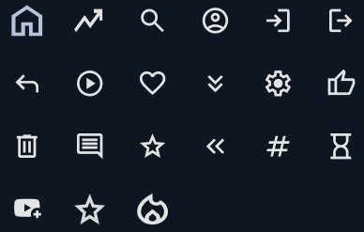
UI Design Kit : Icons
Icons

Slide 26


UI Design Kit : Nav Bar
Before login
After login

Slide 27
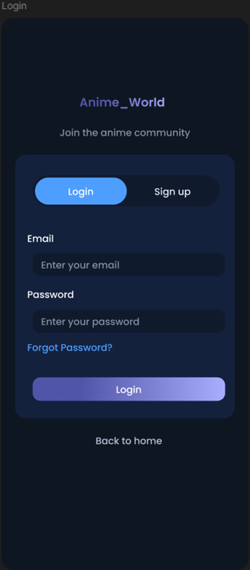
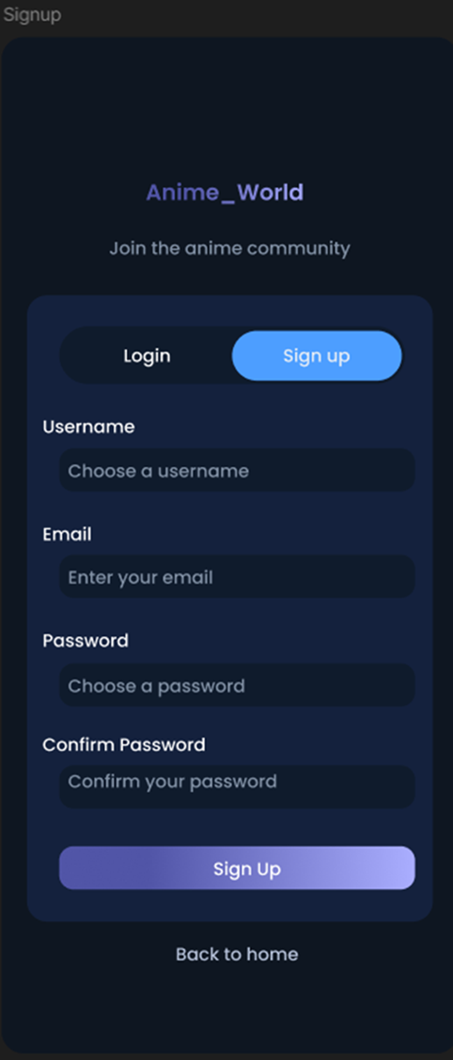
Low fidelity
High fidelity
Low fidelity
High fidelity
Login
Sign Up

Slide 28
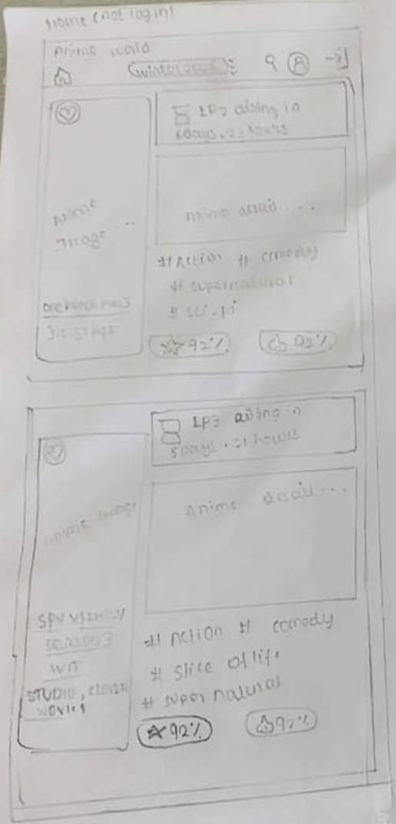
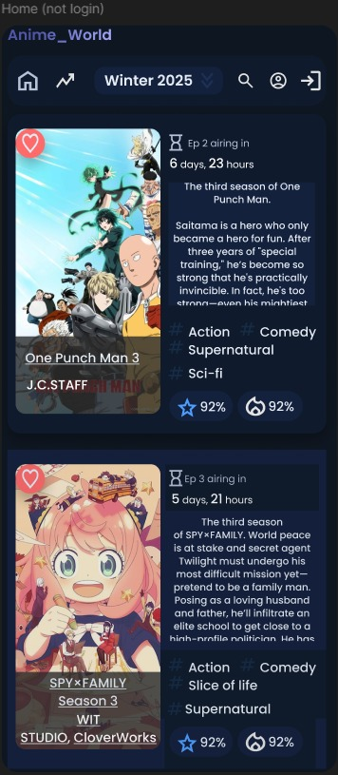
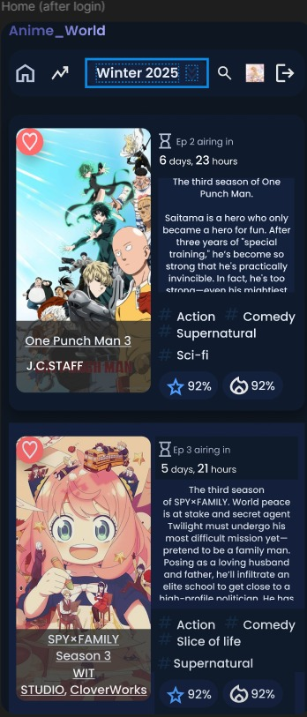
Low fidelity
High fidelity
Low fidelity
High fidelity
Home (Before Login)
Home (After Login)

Slide 29
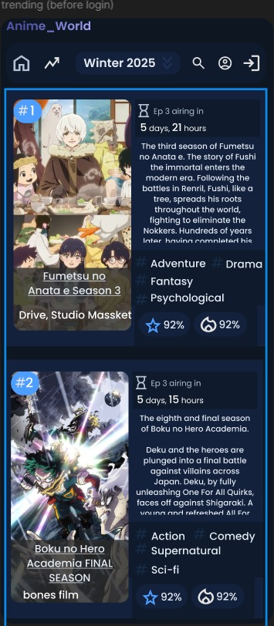
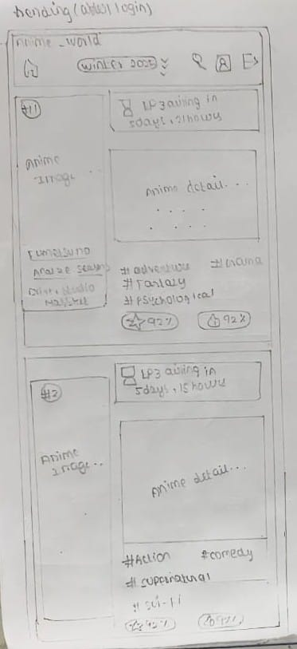
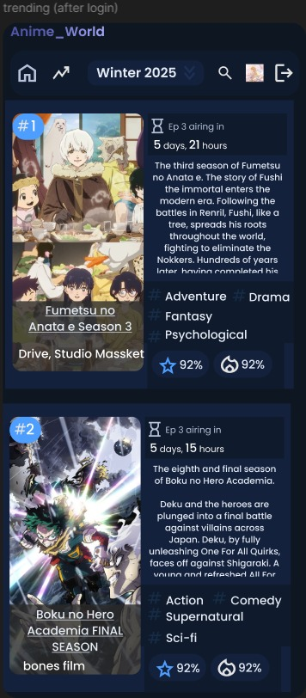
Low fidelity
High fidelity
Low fidelity
High fidelity
Trending (Before Login)
Trending (After Login)

Slide 30
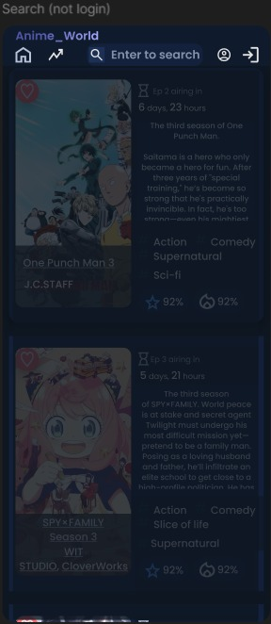
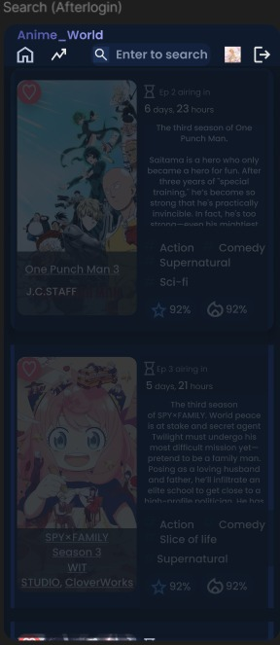
Low fidelity
High fidelity
Low fidelity
High fidelity
Search (Before Login)
Search (After Login)

Slide 31
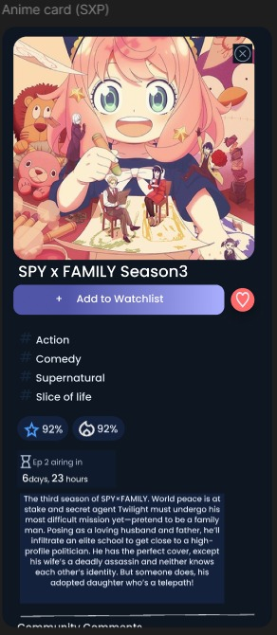
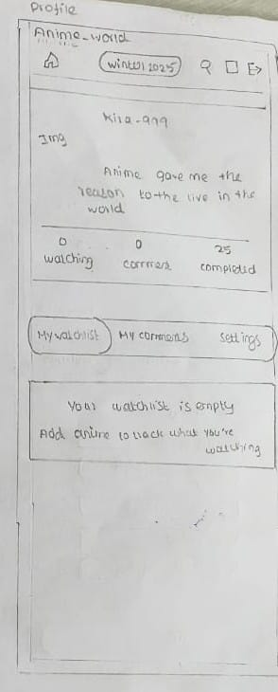
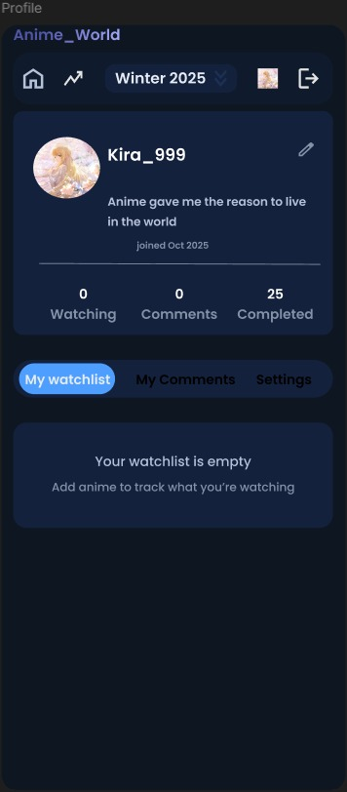
Low fidelity
High fidelity
Low fidelity
High fidelity
Anime Card
Profile (My Watchlist)

Slide 32
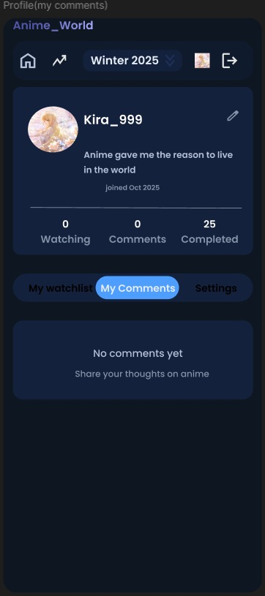
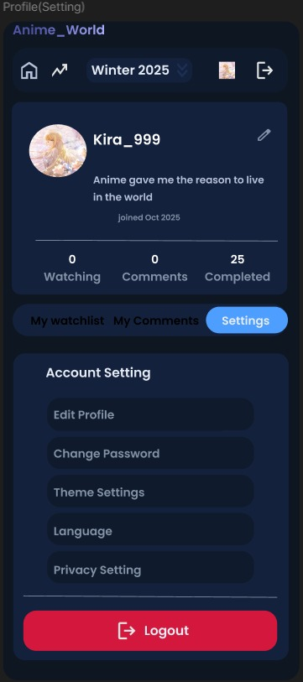
Low fidelity
High fidelity
Low fidelity
High fidelity
Profile (My Comments)
Profile (My Settings)

Slide 33


UI Design Kit : Onboarding Screens
Login Page
Sign Up Page

Slide 34

UI Design Kit : Home screen
Home
Login
Trending
Profile
(Login Required)
Watchlist / Favourite (Login Required)
Search
Home page Before login
Filter by Seasons
Anime Card

Slide 35

UI Design Kit : Home screen
Home
Logout
Trending
Profile
Watchlist / Favourite
Search
Home page After login
Filter by Seasons
Anime Card

Slide 36


UI Design Kit : Screens
Trending page (Before login)
Trending page (After login)

Slide 37


UI Design Kit : Screens
Search page (Before login)
Search page (After login)

Slide 38

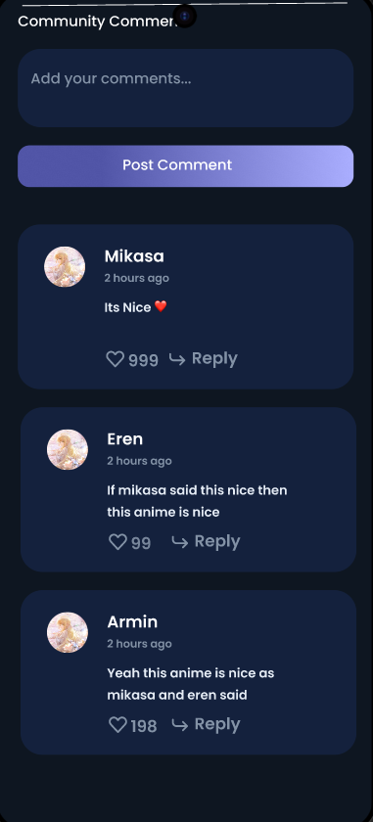
UI Design Kit : Screens
Anime Card
(First Half)
Anime Card (Second Half)

Slide 39



UI Design Kit : Screens
Profile (My Watchlist)
Profile (My Comments)
Profile (My Setting)

Slide 40

Thank You

